Slide 1
UPPER SIXTH ARTS
GEOGRAPHY
Field Work 7
Fieldwork on Settlement
Notes:
Good morning, class, and welcome to our geography lesson. I am your geography teacher, Mr Kamdem. Today we are starting Field Work 7: Fieldwork on Settlement.

Slide 2
CLASS INFO
Class, Chapter and Duration
Class | Upper Sixth Arts
Chapter | Module 8: Understanding and carrying out statistical techniques, topographic map analysis, fieldwork and project based learning
Duration | 2 periods (2 × 50 minutes)
Notes:
This lesson is for Upper Sixth Arts. It belongs to Module 8: Understanding and carrying out statistical techniques, topographic map analysis, fieldwork and project based learning. We shall need 2 periods to cover it.

Slide 3
IDENTIFICATION
Lesson Identification
Topic | Fieldwork in Geography
Sub-topic | Field investigations in human geography
Lesson | Field Work 7: Fieldwork on Settlement
Notions / Concepts | Land-use survey, transect, market threshold, range, segregation, sphere of influence, desire line.
Syllabus focus | Rural land use and settlement variation with distance; market thresholds and range; urban land use and functions (segregation over distance); shopping patterns; urban sphere of influence.
Competence | Learners are able to survey land use and delimit the sphere of influence of a market or town.
Notes:
Our topic is Fieldwork in Geography, and the sub-topic is Field investigations in human geography. The key notions we shall use today are: land-use survey, transect, market threshold, range, segregation, sphere of influence, desire line. At the end, you should be able to do this: learners are able to survey land use and delimit the sphere of influence of a market or town.

Slide 4

HOMEWORK CORRECTION
Correction of the Homework
Question (Field Work 6: Fieldwork on Economic Activities):
Count vehicles passing your house for 15 minutes in the morning and evening and compare.
Notes:
Before we start the new lesson, let us correct the homework I gave you at the end of Field Work 6: Fieldwork on Economic Activities. The question was: Count vehicles passing your house for 15 minutes in the morning and evening and compare. Take out your exercise books.

Slide 5
HOMEWORK CORRECTION
Correction: Possible Answer
Answers vary. Example: morning 42 vehicles (mostly moto-taxis), evening 35. The morning is busier because people go to work, school and the market at the same time.
Notes:
Here is a good answer. Answers vary. Example: morning 42 vehicles (mostly moto-taxis), evening 35. The morning is busier because people go to work, school and the market at the same time. Compare it with your own answer and correct your work in red.

Slide 6
LESSON PLAN
Lesson Plan
Correction of the homework
Objectives and recall
Real-life situation and action to take
Learning activities
Board summary
Evaluation, remediation and homework
Notes:
Here is the plan of our lesson today. First, we shall correct the homework. Then we shall look at the objectives and recall what you already know. After that, we shall study a situation from real life and the action to take, and do the learning activities. Finally, we shall copy the board summary, do the evaluation and the remediation, and I will give you the homework.

Slide 7
OBJECTIVES
Objectives
By the end of this lesson, you should be able to:
Carry out a land-use transect in a town.
Study the range and threshold of a local market.
Notes:
Take your time to copy this part; we will continue together.

Slide 8
OBJECTIVES
Objectives (continued)
Delimit a sphere of influence with desire lines.
Notes:
By the end of this lesson, you should be able to do three things. Number 1: carry out a land-use transect in a town. Number 2: study the range and threshold of a local market. Number 3: delimit a sphere of influence with desire lines.

Slide 9
PREVIOUS KNOWLEDGE
Previous Knowledge
Towns have functional zones.
People travel to markets to buy goods.
Notes:
Let us first remember what you already know. Towns have functional zones. People travel to markets to buy goods. Keep this in mind, because we shall build on it today.

Slide 10
REAL-LIFE SITUATION
Situation in Real Life
The class wants to know how far people travel to the weekly market and how land use changes from the town centre to the edge. They plan a questionnaire at the market and a walk along a main road.
Notes:
Listen carefully to this situation from real life. The class wants to know how far people travel to the weekly market and how land use changes from the town centre to the edge. They plan a questionnaire at the market and a walk along a main road. Think about it, because I am going to ask you some questions.

Slide 11
REAL-LIFE SITUATION
Situation: Question 1
What is the problem in the situation?
Notes:
Question 1: What is the problem in the situation? Think for a moment, then raise your hand to answer.

Slide 12
REAL-LIFE SITUATION
Answer
The class must study land use and the market's influence.
Notes:
Good. The class must study land use and the market's influence.

Slide 13
REAL-LIFE SITUATION
Situation: Question 2
What will they draw from the questionnaire?
Notes:
Question 2: What will they draw from the questionnaire? Think for a moment, then raise your hand to answer.

Slide 14
REAL-LIFE SITUATION
Answer
Desire lines to show the sphere of influence.
Notes:
Good. Desire lines to show the sphere of influence.

Slide 15
REAL-LIFE SITUATION
Situation: Question 3
How will they study land use?
Notes:
Question 3: How will they study land use? Think for a moment, then raise your hand to answer.

Slide 16
REAL-LIFE SITUATION
Possible Answer
With a land-use transect.
Notes:
Good. With a land-use transect.

Slide 17
ACTION TO TAKE
Action to Take
Use fieldwork to understand how our town is organised.
Notes:
From this situation, the action we are working towards in this lesson is the following: use fieldwork to understand how our town is organised.

Slide 18
JUSTIFICATION
Justification of the Lesson
This fieldwork helps us to study the organisation of our settlements.
Notes:
Why is this lesson important for you? This fieldwork helps us to study the organisation of our settlements.

Slide 19
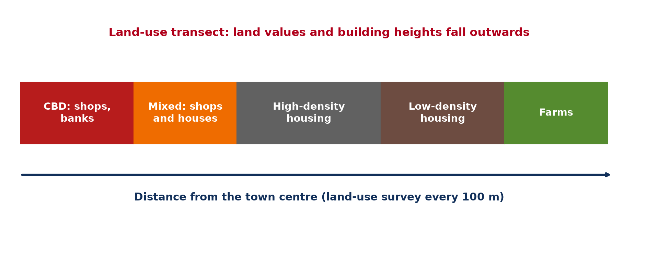
1. LAND-USE TRANSECT
Activity 1
Land-use transect.
Notes:
Activity 1. Look carefully at this diagram: land-use transect. Observe every detail before I ask the question.

Slide 20
1. LAND-USE TRANSECT
Activity 1: Question
How does land use change from the centre outwards?
Notes:
Here is the question for Activity 1: How does land use change from the centre outwards? Take one minute to think and write your answer in your rough notebook.

Slide 21
1. LAND-USE TRANSECT
Activity 1: Answer
From shops and banks to mixed use, then housing and finally farms.
Notes:
Let us check the answer together. From shops and banks to mixed use, then housing and finally farms.

Slide 22

1. SEGREGATION
Activity 2
A town seen from above.
Notes:
Activity 2. Look carefully at this picture: a town seen from above. Observe every detail before I ask the question.

Slide 23
1. SEGREGATION
Activity 2: Question
Why do building heights fall away from the centre?
Notes:
Here is the question for Activity 2: Why do building heights fall away from the centre? Take one minute to think and write your answer in your rough notebook.

Slide 24
1. SEGREGATION
Activity 2: Answer
Land is more expensive in the accessible centre, so people build upwards.
Notes:
Let us check the answer together. Land is more expensive in the accessible centre, so people build upwards.

Slide 25

2. THRESHOLD AND RANGE
Activity 3
Range and threshold.
Notes:
Activity 3. Look carefully at this diagram: range and threshold. Observe every detail before I ask the question.

Slide 26
2. THRESHOLD AND RANGE
Activity 3: Question
Distinguish range and threshold.
Notes:
Here is the question for Activity 3: Distinguish range and threshold. Take one minute to think and write your answer in your rough notebook.

Slide 27
2. THRESHOLD AND RANGE
Activity 3: Answer
Range: maximum distance people travel. Threshold: minimum customers needed.
Notes:
Let us check the answer together. Range: maximum distance people travel. Threshold: minimum customers needed.

Slide 28
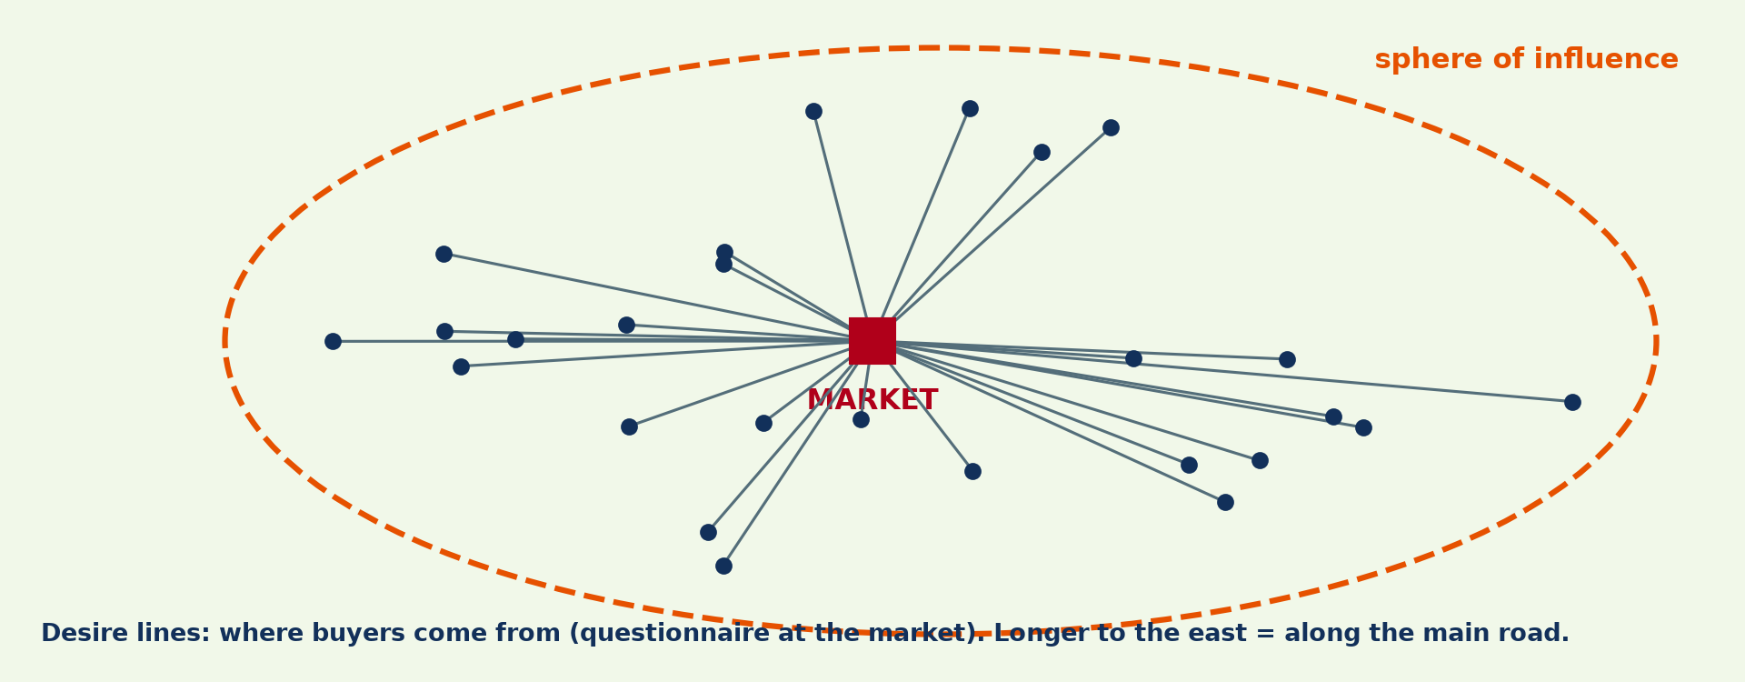
3. SPHERE OF INFLUENCE
Activity 4
Desire lines to a market.
Notes:
Activity 4. Look carefully at this diagram: desire lines to a market. Observe every detail before I ask the question.

Slide 29
3. SPHERE OF INFLUENCE
Activity 4: Question
How are desire lines drawn?
Notes:
Here is the question for Activity 4: How are desire lines drawn? Take one minute to think and write your answer in your rough notebook.

Slide 30
3. SPHERE OF INFLUENCE
Activity 4: Answer
Lines from each buyer's home village to the market, based on questionnaires.
Notes:
Let us check the answer together. Lines from each buyer's home village to the market, based on questionnaires.

Slide 31

3. SHOPPING PATTERNS
Activity 5
A market.
Notes:
Activity 5. Look carefully at this picture: a market. Observe every detail before I ask the question.

Slide 32
3. SHOPPING PATTERNS
Activity 5: Question
Why do people travel further for high-order goods?
Notes:
Here is the question for Activity 5: Why do people travel further for high-order goods? Take one minute to think and write your answer in your rough notebook.

Slide 33
3. SHOPPING PATTERNS
Activity 5: Answer
They are bought rarely and found only in bigger centres.
Notes:
Let us check the answer together. They are bought rarely and found only in bigger centres.

Slide 34
BOARD SUMMARY
Board Summary
Topic: Fieldwork in Geography
Sub-topic: Field investigations in human geography
Field Work 7: Fieldwork on Settlement
Notes:
Now we are going to copy the board summary. Write the title and the headings neatly in your notebooks. I will give you enough time for each slide, so do not rush.

Slide 35
BOARD SUMMARY
1. Land Use and Functions
Land use in settlements is studied as follows:
Land-use transect: Land use is recorded along a line from the centre outwards. It changes from shops and banks to mixed use, then housing and finally farms.
Notes:
Let us copy Land Use and Functions. Land use in settlements is studied as follows. On this slide we have Land-use transect. Write each point on a new line, with the key term first, and explain it in your own words when we revise. When you finish, we go to the next slide.

Slide 36
BOARD SUMMARY
1. Land Use and Functions (continued)
Segregation over distance: Building height, density and land value fall away from the centre. Rich and poor residential areas are also separated.
Notes:
We continue with Land Use and Functions. On this slide we have Segregation over distance. Write each point on a new line, with the key term first, and explain it in your own words when we revise.

Slide 37
BOARD SUMMARY
1. Land Use and Functions
Illustration: land-use transect
Notes:
Now draw this illustration in your notebook: land-use transect. Give it a title and label it clearly.

Slide 38
BOARD SUMMARY
2. Market Threshold and Range
Markets are studied with these concepts:
Threshold: It is the minimum number of customers needed for a service to survive. High-order services need large thresholds.
Range: It is the maximum distance people travel to buy a good. People travel further for high-order goods.
Notes:
Let us copy Market Threshold and Range. Markets are studied with these concepts. On this slide we have Threshold and Range. Write each point on a new line, with the key term first, and explain it in your own words when we revise.

Slide 39
BOARD SUMMARY
2. Market Threshold and Range
Illustration: range and threshold
Notes:
Now draw this illustration in your notebook: range and threshold. Give it a title and label it clearly.

Slide 40
BOARD SUMMARY
3. Sphere of Influence
The sphere of influence is delimited as follows:
Method: Buyers are asked where they come from, and their origins are mapped. Desire lines are drawn from each origin to the market.
Notes:
Let us copy Sphere of Influence. The sphere of influence is delimited as follows. On this slide we have Method. Write each point on a new line, with the key term first, and explain it in your own words when we revise. When you finish, we go to the next slide.

Slide 41
BOARD SUMMARY
3. Sphere of Influence (continued)
Boundary and explanation: A line joining the outer origins shows the sphere of influence. Its size depends on the size of the market and on transport.
Notes:
We continue with Sphere of Influence. On this slide we have Boundary and explanation. Write each point on a new line, with the key term first, and explain it in your own words when we revise.

Slide 42
BOARD SUMMARY
3. Sphere of Influence
Illustration: desire lines to a market
Notes:
Now draw this illustration in your notebook: desire lines to a market. Give it a title and label it clearly.

Slide 43
FORMATIVE EVALUATION
Evaluation 1
Give the steps to delimit a market's sphere of influence.
Notes:
Now let us check what you have understood. Question 1: Give the steps to delimit a market's sphere of influence. Answer in your exercise book.

Slide 44
FORMATIVE EVALUATION
Expected Answer
Questionnaire buyers, map their origins, draw desire lines, draw the boundary.
Notes:
The expected answer is: questionnaire buyers, map their origins, draw desire lines, draw the boundary. If you got it right, well done.

Slide 45
FORMATIVE EVALUATION
Evaluation 2
What is a threshold?
Notes:
Now let us check what you have understood. Question 2: What is a threshold? Answer in your exercise book.

Slide 46
FORMATIVE EVALUATION
Expected Answer
The minimum number of customers needed for a service.
Notes:
The expected answer is: the minimum number of customers needed for a service. If you got it right, well done.

Slide 47
REMEDIATION
Remediation
Fill in the blanks:
Lines from home to market are ______ lines.
The area served by a market is its ______ of influence.
The maximum travel distance is the ______.
Notes:
For those who need more practice, fill in the blanks in your exercise book. The answers are: number 1, desire; number 2, sphere; number 3, range.

Slide 48
HOMEWORK
Homework
Ask ten buyers at a market where they come from and draw desire lines on a sketch map.
Notes:
For your homework: Ask ten buyers at a market where they come from and draw desire lines on a sketch map. We shall correct it at the beginning of our next lesson.

Slide 49
BILINGUAL GAME
Bilingual Game (Jeu Bilingue)
English | Français
Land use | L'occupation du sol
Market | Le marché
Customer | Le client
Range | La portée
Threshold | Le seuil
Sphere of influence | L'aire d'influence
Notes:
Let us play the bilingual game. I say a word in English, and you give me the French word. Then we do the reverse.

Slide 50
LOGBOOK
Official Logbook (1/2)
Module / Topic | Fieldwork in Geography
Lesson Title | Field Work 7: Fieldwork on Settlement
Expected Learning Outcomes | Carry out a land-use transect in a town. Study the range and threshold of a local market. Delimit a sphere of influence with desire lines.
Competence | Learners are able to survey land use and delimit the sphere of influence of a market or town.
Notes:
I record this information in the official logbook of the class after the lesson.

Slide 51
LOGBOOK
Official Logbook (2/2)
Matter Taught | Land Use and Functions; Market Threshold and Range; Sphere of Influence.
Evaluation | Formative evaluation and remediation exercise.
Homework | Ask ten buyers at a market where they come from and draw desire lines on a sketch map.
Enrolment / Present / Absent | ____ / ____ / ____
Achievement | To be completed after the lesson.
Notes:
I complete the second page of the logbook: the matter taught, the evaluation, the homework and the attendance.

Slide 52
TEACHER'S NOTE
Teacher's Note
Timing: Homework correction, plan, objectives 8 min | Recall, situation, action 10 min | 5 activities 30 min | Board summary (copying) 30 min | Evaluation, remediation 10 min | Homework, next lesson 5 min | Logbook 7 min
Without the projector (Activity 1): walk a transect.
Without the projector (Activity 2): compare buildings.
Without the projector (Activity 3): ask sellers.
Without the projector (Activity 4): draw desire lines.
Without the projector (Activity 5): discuss shopping.
Notes:
This slide is for me, the teacher: it gives the timing of the lesson and what to do if the projector is not available.

Slide 53
REFERENCES
References
National Geography Syllabus, MINESEC/IGE/IP-SS, 2019 — Module 8 (Practical Geography).
Photo, Activity 2: “Douala” by christing-O-, CC BY 2.0, via Flickr (https://www.flickr.com/photos/76187282@N00/7227535754)
Photo, Activity 5: “Sandga Market in Douala, Cameroon” by The Advocacy Project, CC BY-NC-SA 2.0, via Flickr (https://www.flickr.com/photos/42487558@N00/3636438732)
Diagrams and animations: drawn for this lesson (Geography Department).
Notes:
These are the references and picture credits used to prepare this lesson.

